Slide 1
Westchester County Continuum of Care Partnership for the Homeless
Recertification Process Meeting
July 13, 2010

Slide 2
HUD requirements
In March 2010, HUD distributed a revised version of the Data Standards for HMIS
New set of Program Description elements (section 2 of standards)
Revisions for Data Standards for Universal Data Elements and Program Specific Data Elements (sections 3 & 4 of standards)
The full PDF version is available at http://www.hudhre.info/documents/FinalHMISDataStandards_March2010.pdf

Slide 3
What this means
Providers need to make these revisions to their intake materials by 6/1/10 so we have the required data necessary beginning on 6/1/2010 to complete the 6/1/2011 reports

Slide 4
Where we are
Everyone here should have received and reviewed “paper” materials from Yoav:
        Entry assessment
        Annual assessment
        Exit assessment
        Housing Status category definitions
These materials REPLACE the prior intake materials
They are posted on PD&D wiki
Feedback/suggestions/comments
Notes:
ASK FOR FEEDBACK ON HOW THE NEW FORMS ARE WORKING, DO THEY TRANSFER WELL TO HMIS, SUGGESTIONS FOR ENTIRE PROCESS?

Slide 5
Program Specific Data Elements (section 4), pages 66-104
The following now need to be collected at entry, exit and ANNUALLY and on all clients (including children):
  Income and Sources
  Non-Cash benefits
  Physical Disability
  Developmental Disability
  HIV/AIDS
  Mental Health
  Chronic Health Condition

Slide 6
Program Specific Data Elements, continued
Income and Sources (p. 66); collect at entry, exit and annually for all clients; A general question on whether any income has been received in the last 30 days has been added but capturing the dollar amount is optional.

Slide 7
Program Specific Data Elements, continued
Non-cash Benefits (p. 69); collect at entry, exit and annually for all clients. A general question on whether any non-cash benefit has been received has been added, as well as response categories to determine if a client is receiving a non-cash benefit from each source. Response category 12 has been changed to clarify that it refers specifically to ongoing rental assistance. A new response category 14 has been added to track temporary rental assistance.

Slide 8
Program Specific Data Elements, continued
Physical Disability, Developmental Disability, HIV/AIDS, Mental Health (p72-81): collect at entry, exit and annually for all clients. A question related to services or treatment has been added. Response categories for “Don’t Know” and “Refused” were also added. Documentation in chart required.

Slide 9
Chronic Health Condition; NEW ITEM (p.76) collect at entry, exit and annually for all clients. A chronic health condition means a diagnosed condition that is more than three months in duration and is either not curable or has residual effects that limit daily living and require adaptation in function or special assistance. Examples of chronic health conditions include, but are not limited to, heart disease (including coronary heart disease, angina, heart attack and any other kind of heart condition or disease); severe asthma; diabetes; arthritis-related conditions (including arthritis, rheumatoid arthritis, gout, lupus, or fibromyalgia); adult onset cognitive impairments (including traumatic brain injury, post-traumatic distress syndrome, dementia, and other cognitive related conditions); severe headache/migraine; cancer; chronic bronchitis; liver condition; stroke; or emphysema. Documentation in chart required.

Slide 10
Program Specific Data Elements, continued
Substance Abuse; collect at entry, exit and annually for all clients. The “dually diagnosed” response category has been changed to “Both alcohol and drug abuse.” A response option of “No” was added to the “Substance abuse problem” question. A question related to treatment has been added. Response categories for “Don’t Know” and “Refused” were also added.

Slide 11
Program Specific Data Elements, continued
If you check “yes” to ANY of these disabling conditions (Mental Health, Substance Abuse, Developmental Disabilities, Chronic Health Condition) there must be corresponding documentation in the chart. Documentation can be from a licensed professional or SSA or a receipt from an SSDI or VA check. This must also be done annually.

Slide 12
Program Specific Data Elements, continued
Optional data elements (p 93-105)
  Employment, Adult Education; Under the revised notice, this information may be collected from all persons served or just all adults and unaccompanied youth. Response categories for “Don’t Know” and “Refused” were added. Includes the recommendation that this information be collected at program entry, program exit and on an annual basis.
  General Health Status; Under the revised notice, this information may be collected from all persons served or just all adults and unaccompanied youth. Response category for “Refused” was added. Includes the recommendation that this information be collected at program entry, program exit and on an annual basis.
  Pregnancy Status; responses for “don’t know” and “refused” were added

Slide 13
Program Specific Data Elements, continued
  Veteran’s Info; Response categories for “Don’t Know” and “Refused” were added to each field in this data element. Also, two reporting categories were deleted: (1) Between WWI and WWII, December 1918 – August 1940; and (2) World War I, April 1917 - November 1918. Following the latest guidance received from the Department of Veterans Affairs, the date range for the response value “Persian Gulf Era” has been revised to end on September 10, 2001. A new response value has been added to represent the period after September 11, 2001. In addition, “Afghanistan” has been added as a separate category under the list of war zones.

Slide 14
Program Specific Data Elements, continued
  Children’s Education; “don’t know” and “refused” were added; recommended to be collected at entry, exit and annually.
  Reason for Leaving; used to be required; now optional
  Services Provided; used to be required; now optional

Slide 15
Program Specific Data Elements; Street Outreach Only, pgs 86-88
Date of Contact (required for street outreach only); NEW ITEM; completed on all clients each time they are contacted
Date of Engagement (required for street outreach only); NEW ITEM; completed on all clients during assessment

Slide 16
Program Specific Data Elements; HPRP-funded programs only; pgs 88-93
Financial Assistance Provided (HPRP only); NEW ITEM; completed on all clients served when HPRP financial assistance is provided as a one-time transaction and at least once every three months for participants receiving medium-term rental assistance.
Housing Relocation and Stabilization (HPRP only); NEW ITEM; completed on all clients served at least once every three months during program enrollment, if the period between program entry and exit exceeds three months, and at program exit.

Slide 17
Annual Data
How can clients who require an annual assessment be effectively identified and tracked in HMIS?
Use the following steps:
1) Login to Clienttrack
2) Click on the User Home tab
3) On the left menu, click on the report 'Open Enrollments w/ Most Recent Assessment'
4) Sort in descending order by 'Most Recent Assessment Date for this Program'

Slide 18
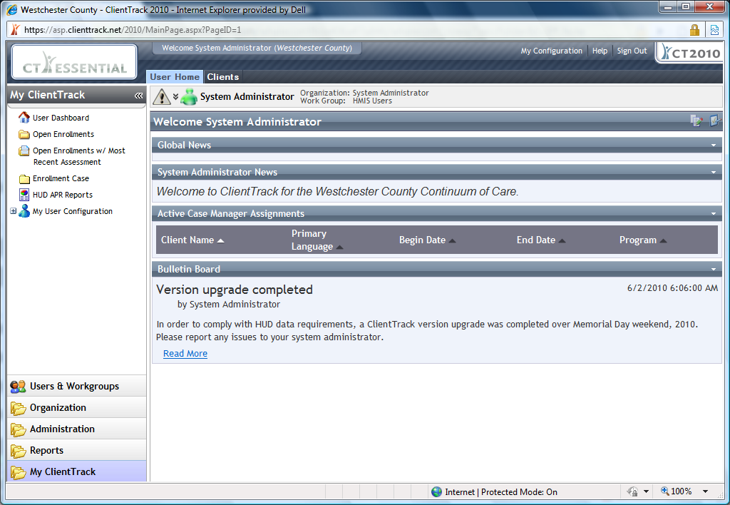

Slide 19
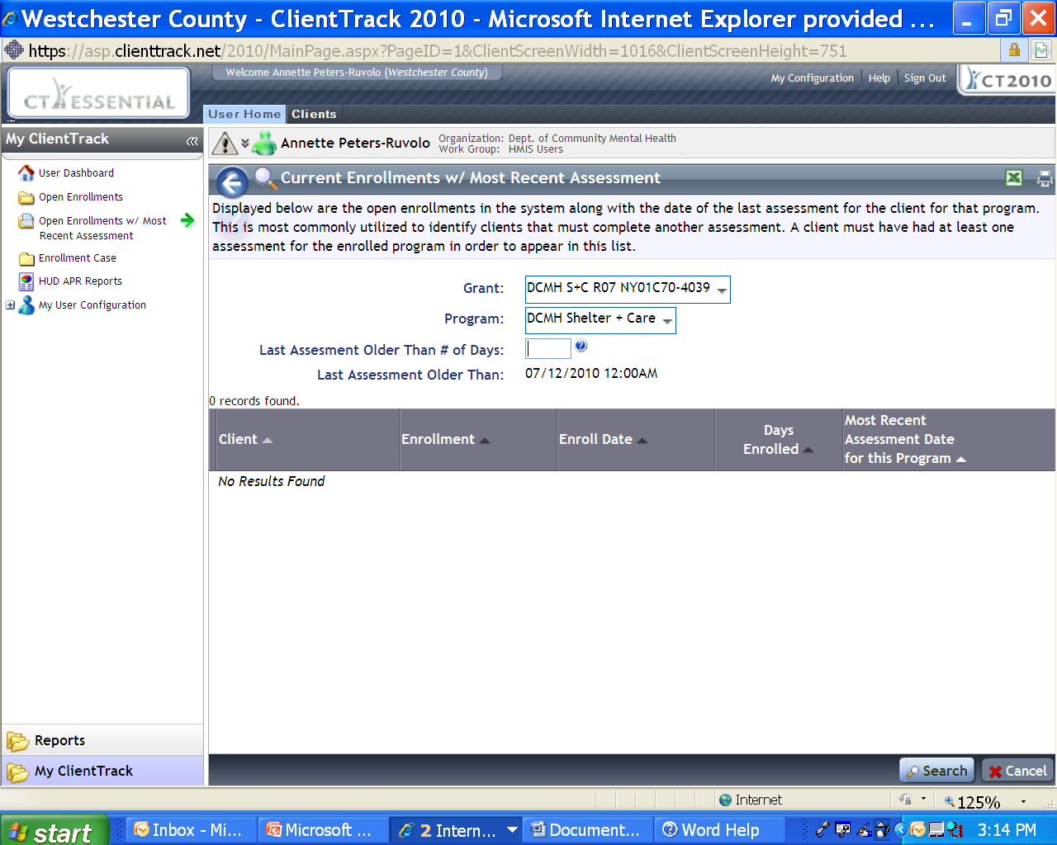

Slide 20
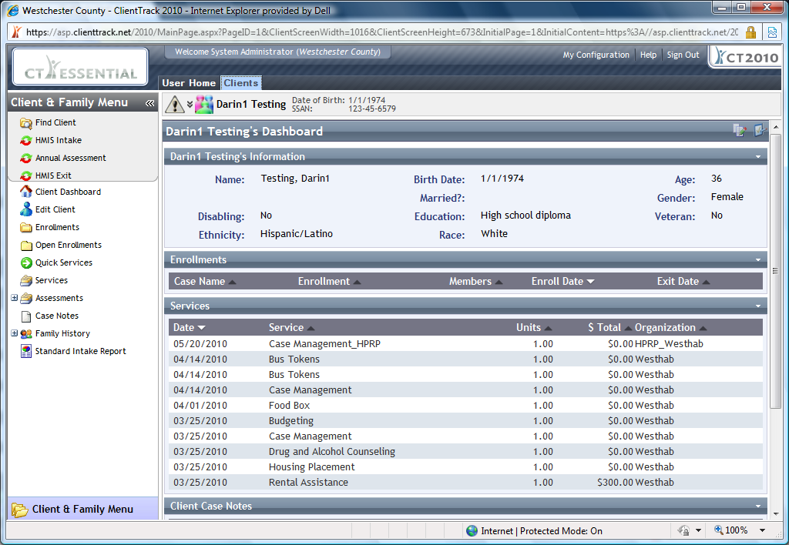

Slide 21
Important Points
Getting data up to date in HMIS is critical to our continued success in obtaining and maintaining HUD funding. HMIS data should be entered on a rolling basis.
Vouchers: must be on time and must be submitted monthly for draw down to be efficient
Contact your grantee if outstanding issues.
Notes:
Refer to AHAR – will be incredibly difficult to do accurately w/o up to date data. Sample policy/procedure. Superuser concept

Slide 22
CoC Plan
Grantees will be asking all providers to produce and send APR on 7/15/2010
Grantees will report findings and actual APRs to Annette Peters/DCMH for tabulation by 7/31/2010; problem areas will be identified and addressed
Annette to attend HUD sponsored 4 day training on HEARTH and HMIS in September
In preparation for HEARTH, governance policy/procedures and agreements will be developed/enacted to include HMIS standards that will be used to determine future funding allocations.

Slide 23
In Sum
Revisions to intake process should have been made and data should be getting collected by providers. A revised version of the PD&D Intake is available at the wiki
http://programdesign.com/wiki/Main_Page
Annette to send this power point via e-mail; post to PD&D wiki
Feel free to contact your grantee or Annette at 995-5278 or apr5@westchestergov.com with questions
Thank You!

