Slide 1
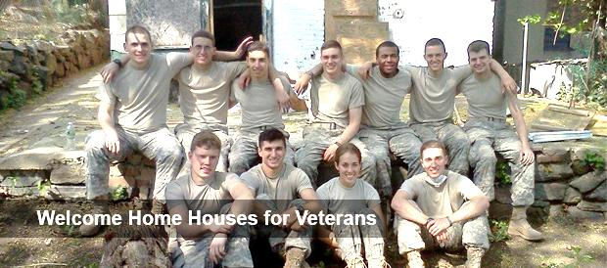

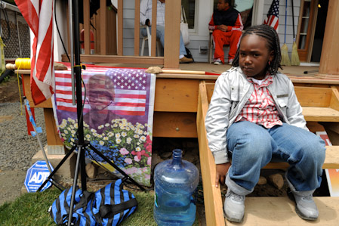
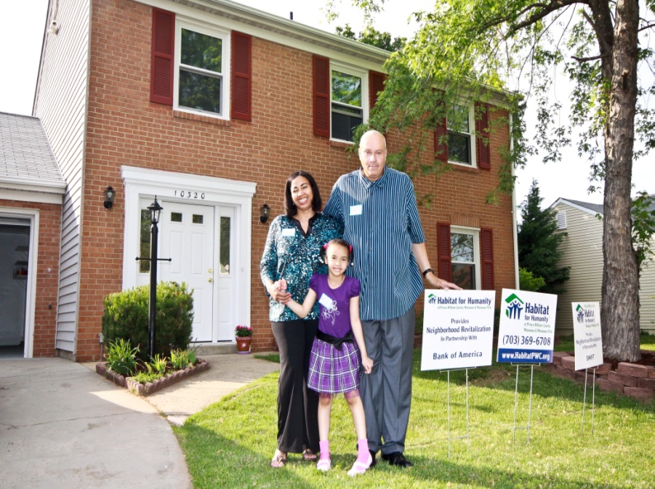



Habitat for Humanity of Westchester helping Veterans
Help themselves!
VETERANS CAN LIVE THE AMERICAN DREAM!
Habitat for Humanity of Westchester does not only built homes, but also builds hope. Each home that we build is filled with countless hours of caring, dedication and hard work. Our habitat partner families work side by side with sponsors, volunteers, and staff members to build their dream home.
We’ve helped five Veterans into organization thus far.
Training programs are available to help Veterans learn how to build.
HFHWC is constantly working on “Welcome home houses.”
Coming back to a home and a job!
For more information:
Contact
(914) 636- 8335 ext. 106
www.habitatwc.org

Slide 2

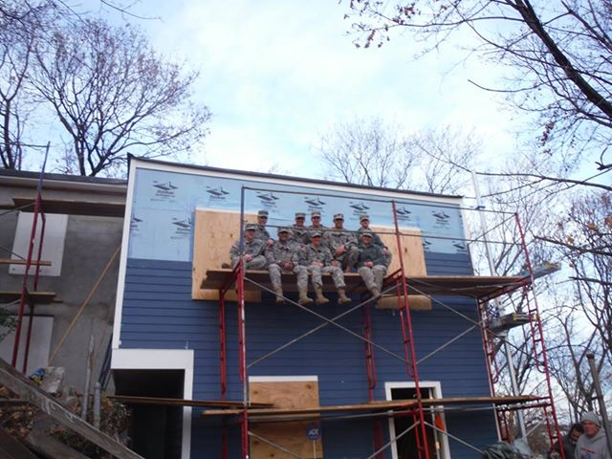
Why is Habitat for Humanity focusing on Veteran needs?
Veterans Outreach Mission Statement
Veterans initiation:
Veterans Build is Habitat for Humanity of Westchester initiation to provide housing solutions and volunteer and employment opportunities to U.S. Veterans, Military Service Members and their families.
Veterans Build focuses on five inter-related areas:
1. Build: Provide simple, decent and affordable housing solutions for military, veterans and their families.
2. Mobilize: Engage West Point Cadets, Navy, Army, National Guard, and Coast Guard.
3. Employ: Capitalize on skill sets gained from military service with recruitment targeting veterans as to help run all aspects of Habitat for Humanity Westchester affiliate employees, board members and extended volunteers, national service members, interns and fellows.
4. Educate: Promote education to Military and to Veterans providing access to financial literacy and homeownership education programs.
5. Honor: Host regular slate of events highlighting veteran housing needs and honoring their service. Target dates include the 9/11 Day of Service, MLK Day Service and Veterans Day.
Veterans outreach is an affiliate of Habitat for Humanity of Westchester. Veterans helping Veterans help themselves. Veterans outreach was established in 2003 to encourage young Veterans to plan for a successful future.
This program allows those returning from War torn countries a chance to reintegrate into society. Habitat for Humanity of Westchester Veterans outreach invites all former Armed forces to volunteer, build homes, gain knowledge and training on work sites. Employment opportunities are also available through Habitat for Humanity of Westchester, and Interest free loans are granted to those who qualify.
Nearly 4 million Veteran households pay more than 30 percent of income for housing.
More than 1.5 million of these households pay more than 50 percent of income for housing (severe cost burden).
Nearly one million Veterans who own homes are severely cost burdened, despite having access to VA loans and other assistance.
A substantial subset of Veterans struggles economically.
Approximately 1.4 million Veterans (6.7 percent) live in poverty.

